Slide 1

DATA ANALYSIS PRESENTATION BY TECH SAVVY
TEAM MEMBERS : AMON KR. MAHATO
ANAMIKA DAS
RISHIKA BHUNIA

Slide 2

Introduction :
IMDb, which stands for the Internet Movie Database, is an online database that provides information about films, television programs, video games, and streaming content. It is one of the most popular and comprehensive resources for information related to the entertainment industry. IMDb is widely used by professionals in the film and television industry, as well as by enthusiasts and casual viewers.
Key features of IMDb include:
Film and TV Databases
User Ratings and Reviews
Celebrities and Crew Profiles
Box Office Information
News and Updates
Streaming Information
Col Needham
(Founder and CEO of IMDb)

Slide 3

Performing IMDb data analysis involves several steps, from data acquisition to interpretation of results. Below are the general steps for IMDb data analysis: 1.Data Collection: Obtain IMDb datasets: Download relevant datasets from IMDb or use web scraping techniques to gather specific data.(Choosing datasets based on our analysis goals, such as movies, TV shows, actors, ratings, and more). 2.Data Cleaning and Preprocessing: Handle missing data: Identify and address missing values through imputation or removal. Remove duplicates: Ensure there are no duplicate entries in the dataset. Standardize and format data: Ensure consistency in data formats (e.g., date formats, categorical variables). Convert data types: Adjusting data types as needed for analysis. 3.Exploratory Data Analysis (EDA): Visualize distributions: Create histograms, box plots, and other visualizations to understand the distribution of key variables (ratings, box office earnings, etc.). Explore correlations: Using scatter plots and correlation matrices to identify relationships between variables. Identify trends: Examine trends over time, such as the popularity of genres, average ratings, etc.
Approach :

Slide 4

TECH STACKED USED
Google Drive can be integrated with Excel for collaborative work, allowing users to store, share, and access spreadsheets online, enhancing collaboration and data accessibility.
Excel can organize IMDb data, sorting films, actors, ratings, and more, providing a customizable and accessible database for analysis.
PowerPoint succinctly presents IMDb data, aiding visual storytelling and analysis.

Slide 5
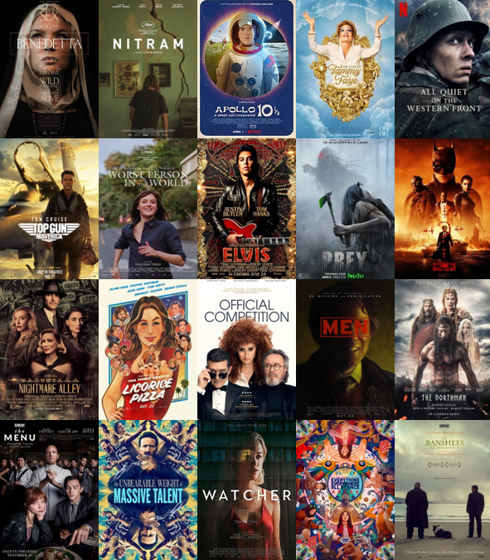
IMDb Top 20 Movies
Movie Title | IMDb Score (1-10)
The Shawshank Redemption | 9.3
The Godfather | 9.2
The Godfather: Part II | 9
The Dark Knight | 9
The Lord of the Rings: The Return of the King | 8.9
Pulp Fiction | 8.9
The Good, the Bad and the Ugly | 8.9
Schindler's List | 8.9
Forrest Gump | 8.8
Fight Club | 8.8
The Lord of the Rings: The Fellowship of the Ring | 8.8
Star Wars: Episode V - The Empire Strikes Back | 8.8
Inception | 8.8
Goodfellas | 8.7
One Flew Over the Cuckoo's Nest | 8.7
The Lord of the Rings: The Two Towers | 8.7
The Matrix | 8.7
Seven Samurai | 8.7
City of God | 8.7
Star Wars: Episode IV - A New Hope | 8.7

Slide 6
Countries which produced Max number of Movies
Country | Count of Title
USA | 2944
UK | 304
France | 104
Germany | 79
Canada | 63
Australia | 39
Spain | 22
Japan | 16
China | 14
India | 14
Hong Kong | 13
Italy | 11
Mexico | 10
Denmark | 9
New Zealand | 9
South Korea | 8
Ireland | 7
Brazil | 5
Thailand | 4
Iran | 4
Norway | 4

Slide 7
Top 10 Movies with highest Profit
Movie Title | Profit
Avatar | ₹ 52,35,05,847
Jurassic World | ₹ 50,21,77,271
Titanic | ₹ 45,86,72,302
Star Wars: Episode IV - A New Hope | ₹ 44,99,35,665
E.T. the Extra-Terrestrial | ₹ 42,44,49,459
The Avengers | ₹ 40,32,79,547
The Lion King | ₹ 37,77,83,777
Star Wars: Episode I - The Phantom Menace | ₹ 35,95,44,677
The Dark Knight | ₹ 34,83,16,061
The Hunger Games | ₹ 32,99,99,255
The Hunger Games: Catching Fire | ₹ 29,46,45,577
Jurassic Park | ₹ 29,37,84,000
Despicable Me 2 | ₹ 29,20,49,635
American Sniper | ₹ 29,13,23,553
Finding Nemo | ₹ 28,68,38,870
Shrek 2 | ₹ 28,64,71,036
The Lord of the Rings: The Return of the King | ₹ 28,30,19,252
Star Wars: Episode VI - Return of the Jedi | ₹ 27,66,25,409
Forrest Gump | ₹ 27,46,91,196
Star Wars: Episode V - The Empire Strikes Back | ₹ 27,21,58,751

Slide 8
Distribution of IMDb Rating among various Genre
Genre | IMDb Score (1-10)
Crime | 9.3
Action | 9
Western | 8.9
Biography | 8.9
Drama | 8.8
Comedy | 8.8
Adventure | 8.6
Horror | 8.5
Mystery | 8.5
Documentary | 8.5
Sci-Fi | 8.2
Animation | 8
Fantasy | 7.9
Family | 7.9
Musical | 7.2
Romance | 7.1
Thriller | 6.3

Slide 9
Most Revenue fetching Category for a movie.
Genre | Gross Revenue
Action | $67,54,08,90,818
Comedy | $38,02,79,93,497
Adventure | $30,97,13,35,977
Drama | $20,04,54,18,442
Crime | $8,11,97,07,029
Biography | $7,49,49,03,091
Horror | $5,19,89,71,387
Animation | $3,81,06,74,545
Fantasy | $1,39,98,95,199
Mystery | $1,12,79,63,819
Documentary | $54,82,15,042
Family | $44,74,81,433
Sci-Fi | $20,85,74,725
Musical | $18,41,68,000
Romance | $6,26,59,016
Western | $4,77,43,768
Thriller | $1,21,539
According to the data set we can see that Action genre had generated the highest revenue with $ 67,59,97,69,950 and Thriller had generated the lowest revenue $ 1,21,539.

Slide 10

Why do people watch Action movies more compare to Thriller?
While action movies and thrillers share some similarities, they also have distinct characteristics that appeal to different audiences. Here are a few reasons why some people may prefer action movies over thrillers:
Intensity and Pacing: Action movies are known for their high-energy sequences, fast-paced chases, and explosive stunts.
Clear Heroes and Villains: Action movies often feature clear distinctions between heroes and villains, with protagonists facing external threats.
Visual Spectacle: Action movies often prioritize visual effects, elaborate set pieces, and grandiose scenes.
Simpler Plot Structures: Action movies typically have simpler and more linear plot structures.
Escapism and Fantasy Elements: Action movies often take place in fantastical worlds or involve extraordinary scenarios that allow for a greater degree of escapism.
Physicality and Combat: Action movies frequently feature physical combat, martial arts, or epic battles, providing a visceral and engaging experience.
Genre Expectations: Audiences often have specific genre preferences, and action movies have built a dedicated fan base over the years. People may be drawn to action due to established franchises, iconic characters, or a long-standing love for the genre.

Slide 11
Genre-Budget Allocation
Genre | Budget
Action | $62,94,76,20,569
Comedy | $35,70,94,57,007
Adventure | $24,92,64,29,575
Drama | $19,24,99,48,745
Crime | $10,53,46,21,560
Biography | $5,20,20,44,003
Animation | $2,47,07,30,000
Horror | $2,10,98,60,479
Mystery | $77,94,65,000
Fantasy | $58,63,00,000
Documentary | $37,49,31,311
Sci-Fi | $19,43,50,000
Romance | $12,02,15,000
Family | $4,45,00,000
Western | $81,30,000
Musical | $63,79,000
Thriller | $18,07,000
Here we can see that maximum budget was utilised by Action Genre i.e. $62,94,76,20,569 while Western Genre utilized the lowest of all i.e. $18,07,000.
.

Slide 12

Need of analyzing the Genre Budget Graph :
Analyzing the genre budget graph in IMDb data can provide valuable insights into the relationships between film genres, production budgets, and potentially box office performance. Here are some reasons why the genre budget graph is important in IMDb data analysis:
Budget Allocation Strategies: Understanding how different genres allocate their budgets can provide insights into industry trends and production strategies.
Financial Planning: Filmmakers, studios, and investors can use the genre budget graph to make informed financial decisions. It helps in planning and allocating resources based on the expected budget ranges associated with specific genres.
Return on Investment (ROI) Analysis: Examining the relationship between genre, budget, and box office performance can assist in evaluating the ROI for different genres. This information is crucial for filmmakers and studios to assess the financial success of their projects.
Risk Assessment: For investors and studios, understanding the budgeting patterns within genres helps in assessing the risk associated with different types of films. Some genres may have a higher potential for profitability, while others may be considered riskier investments.
Genre Popularity: Analyzing budgets across genres can reveal which genres are currently popular or in demand. Filmmakers can use this information to align their projects with prevailing market interests.
Marketing Strategies: The genre budget graph can influence marketing strategies. Knowing the budget distribution for specific genres can help in tailoring marketing campaigns to reach the intended audience effectively.

Slide 13



Director | Gross Revenue
Christopher Nolan | $79,17,42,578
Gore Verbinski | $74,49,06,591
Steven Spielberg | $59,86,67,260
Andrew Adamson | $43,33,23,868
Adam Shankman | $42,43,93,350
George Lucas | $38,02,62,555
Brett Ratner | $37,44,40,864
Eric Darnell | $37,31,19,687
Michael Bay | $35,45,58,940
Jon Favreau | $34,63,43,720
Top Directors to Generate Maximum Revenue.
1.
2.
3.
Christopher Nolan
Gore Verbinski
Steven Spielberg

Slide 14



Audience Fav Actor
Lead Actor | Lead Actor FB Likes
Jimmy Bennett | 522000
Robin Williams | 343000
Robert Downey Jr. | 210000
Jason Statham | 182000
J.K. Simmons | 168000
Christian Bale | 161000
Johnny Depp | 160000
Andrew Fiscella | 137000
Leonardo DiCaprio | 116000
Scarlett Johansson | 114000
1.
2.
3.
Jimmy Bennett
Robin Williams
Robert Downey Jr.

Slide 15
Facebook Likes impact of Revenue
Genre | Likes Count | Gross Revenue
Action | 12573461 | $67,54,08,90,818
Comedy | 10309502 | $38,02,79,93,497
Drama | 7602729 | $20,04,54,18,442
Adventure | 4622420 | $30,97,13,35,977
Crime | 3433598 | $8,11,97,07,029
Biography | 3122882 | $7,49,49,03,091
Horror | 1128959 | $5,19,89,71,387
Animation | 551877 | $3,81,06,74,545
Mystery | 318998 | $1,12,79,63,819
Fantasy | 263340 | $1,39,98,95,199
Sci-Fi | 50061 | $20,85,74,725
Western | 49376 | $4,77,43,768
Documentary | 43241 | $54,82,15,042
Family | 21591 | $44,74,81,433
Romance | 16866 | $6,26,59,016
Musical | 5356 | $18,41,68,000
Thriller | 4077 | $1,21,539

Slide 16
Relationship between Social media and Movie Revenue :
The relationship between social media presence and movie revenue is complex and multifaceted. Social media can significantly impact a movie's success through various channels. Here are some ways in which social media can influence movie revenue:
Marketing and Promotion: Social media platforms provide an effective means for film studios to market and promote their movies. Trailers, teasers, posters, and behind-the-scenes content can be shared widely, generating buzz and anticipation among potential viewers.
Audience Engagement: Social media allows for direct interaction with the audience. Engaging with fans, responding to comments, and running promotional campaigns can create a sense of community and loyalty around a movie.
Awareness and Visibility: A strong social media presence can increase a movie's visibility and awareness. Trending hashtags, social media challenges, and other viral marketing techniques can help a movie stand out in a crowded entertainment landscape.
Influencer Marketing: Collaborating with social media influencers and celebrities to promote a film can reach a broader audience.
Real-Time Feedback: Social media provides a platform for immediate audience feedback. Studios can gauge audience reactions, adjust marketing strategies, and even make last-minute changes based on the response from social media platforms.
In conclusion, social media strategy can contribute significantly to a movie's success, it should be part of a broader and well-rounded marketing campaign.

Slide 17

“India Unveiled : A Cinematic Journey 2015”
Country | India
Genre | Gross Revenue | IMDb Score (1-10)
Action | $64,98,000 | 8.4
Title- Baahubali: The Beginning
Lead - Tamannaah Bhatia
Adventure | $40,18,695 | 8
Title - My Name Is Khan
Lead - Shah Rukh Khan
Comedy | $1,38,76,974 | 7.4
Title - Monsoon Wedding
Lead - Naseeruddin Shah
Documentary | $16,892 | 7.6
Title - Ayurveda: Art of Being
Drama | $42,31,500 | 7.8
Title - The Lunchbox
Lead - Nawazuddin Siddiqui
Romance | $1,29,319 | 5.1
Ttitle - Dil Jo Bhi Kahey...
Lead - Annabelle Wallis
Thriller | $49,000 | 4.8
Ttitle - Chocolate: Deep Dark Secrets
Lead - Emraan Hashmi

Slide 18
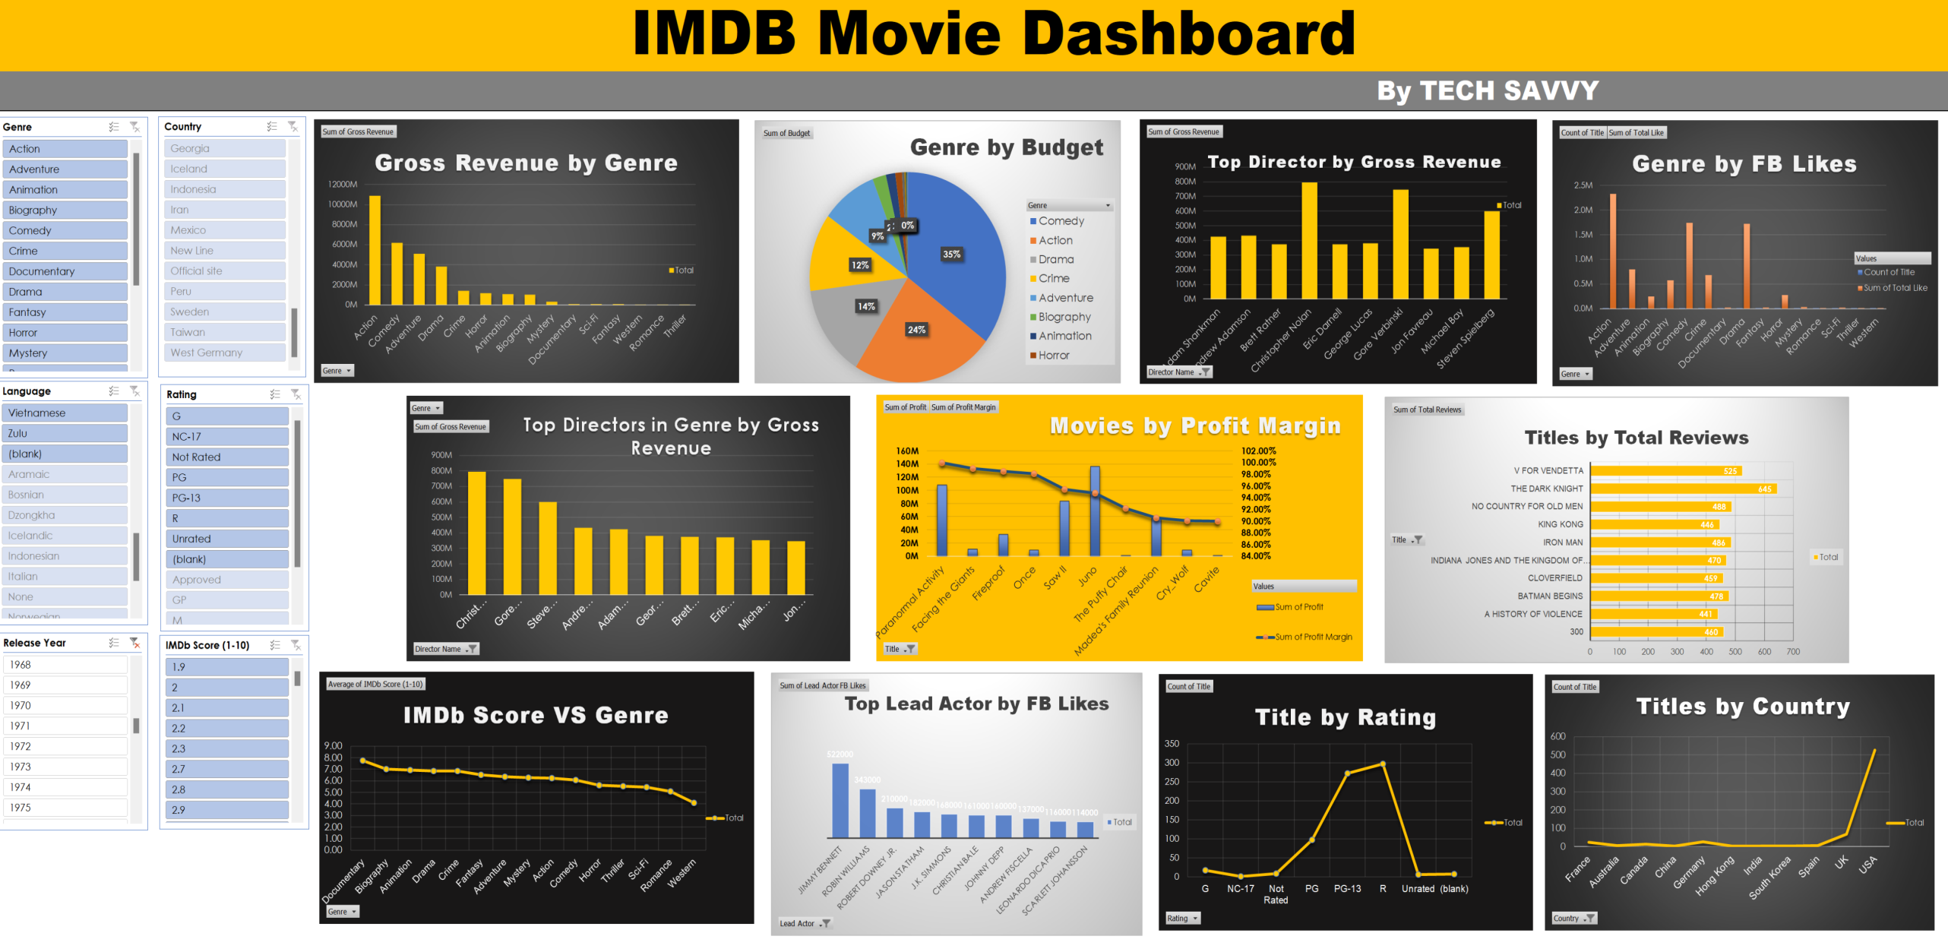

Slide 19

FUTURE SCOPE :
IMDb (Internet Movie Database) is a popular online database that provides information about movies, TV shows, and celebrities. The future scope of IMDb can be envisioned by considering potential developments and trends in the entertainment and technology industries. Please note that these are speculative possibilities, and actual developments may vary:
Enhanced User Experience: IMDb may continue to focus on improving its user interface and experience. This could include more personalized recommendations, interactive features, and innovative ways to explore and discover content.
Advanced Data Analytics: IMDb could leverage advanced data analytics and artificial intelligence to provide more in-depth insights into user preferences, trends in the entertainment industry, and predictive analytics for movie and TV show success.
Interactive Features: The platform may introduce more interactive features, allowing users to engage in discussions, polls, and live events related to movies and TV shows. This could enhance the sense of community among IMDb users.
Global Expansion: IMDb may continue to expand its reach globally, providing localized content, language support, and cultural relevance to a broader audience.
Original Content: IMDb might venture into producing its own original content, such as exclusive interviews, documentaries, or series that delve into the behind-the-scenes aspects of the entertainment industry.
Social Media Integration: IMDb may strengthen its ties with social media platforms, allowing users to share their favorite movies, reviews, and recommendations seamlessly. This could involve deeper integration with social media APIs and features.
Expanded Database: IMDb may continue to expand its database to include more diverse content, such as short films, web series, and independent productions, reflecting the evolving landscape of the entertainment industry, etc.

Slide 20
Conclusion :
In conclusion, the IMDb data analysis project has provided valuable insights into the multifaceted landscape of the entertainment industry. The objectives outlined at the project's inception were met through a systematic approach, encompassing data understanding, cleaning, preprocessing, exploratory data analysis (EDA), and insightful visualizations.
The findings offer actionable insights for industry professionals, from filmmakers and distributors aiming to optimize box office success to talent scouts seeking emerging stars. The comprehensive analysis of IMDb data not only sheds light on current industry trends but also provides a foundation for strategic decision-making and content creation in the ever-evolving world of entertainment
Key Outcomes:
Genre Revenue and Budget: The Action genre emerged as a powerhouse, collecting the highest gross revenue of $67.54 billion, while also featuring prominently in the top 5 genres with the highest budgets.
Director's Impact: Directors showcased exceptional prowess by leading in the category of maximum gross revenue, underlining the influential role directors play in a film's financial success.
Audience Engagement: Action movies gained the highest Facebook likes, emphasizing the genre's popularity among IMDb users.
Actor Popularity: An actor's popularity can have a substantial impact on a movie's revenue, as their fame and fan base can attract a larger audience.

Slide 21
THANK YOU

